Slide 1

A MINI PROJECT REPORT ON DETECTION OF THYROID DISORDERS USING MACHINE LEARNING APPOARCH
SUBMITTED BY:
CH.HARISH 20W91A0542
G.DEEKSHITHA 20W91A0555
K.SURESH 21W95A0501
K.REVANTH 20E31A0542
INTERNAL GUIDE:
Mrs. L. PRIYANKA
ASSISANT PROFESSOR.

Slide 2
CONTENTS
ABSTRACT
INTRODUCTION
EXISTING SYSTEM
DISADVANTAGES
PROPOSED SYSTEM
ADVANTAGES
HARDWARE REQUIREMENTS
SOFTWARE REQUIREMENTS
SYSTEM ARCHITECTURE
CONCLUSION

Slide 3
ABSTRACT
Classification based Machine learning plays a major role in various medical services. In medical field, the salient and demanding task is to diagnose patient’s health conditions and to provide proper care and treatment of the disease at the initial stage. Let us consider Thyroid disease as the example. The normal and traditional methods of thyroid diagnosis involve a thorough inspection and also various blood tests. The main goal is to recognize the disease at the early stages with a very high correctness. Machine learning techniques play a major role in medical field for making a correct decision, proper disease diagnosis and also saves cost and time of the patient.

Slide 4
INTRODUCTION
Diagnosing thyroid disease is complex, involving medical exams and blood tests. The thyroid gland regulates metabolism, growth, and body functions, so proper hormone secretion is essential for overall health. Imbalances can disrupt circulation, temperature control, muscle strength, and brain function. The thyroid gland produces T3, T4, and TSH. TSH, released by the pituitary gland, stimulates T3 and T4 production, regulating metabolism in the body. When TSH is low, T3 and T4 secretion increases, and vice versa. The pituitary gland plays a crucial role in maintaining thyroid hormone balance.

Slide 5
EXISTING SYSTEM
In data collection, low-power, memory-constrained sensors use short-range communication to gather physical environment data.Ethernet, WiFi, ZigBee, and wired tech, along with TCP/IP, link objects and users across extended distances. In data processing, applications analyze data, make decisions, and may execute commands to impact the environment. The convergence of diverse IoT technologies and standards intensifies end-to-end security challenges in IoT applications.
Coordination is crucial to address the inherent heterogeneity and distributed nature of these communication technologies.

Slide 6
DISADVANTAGES
Low Efficiency
Less accuracy

Slide 7
PROPOSED SYSTEM
The thyroid dataset is sourced from Kaggle, containing patient records with essential details. Attributes include medical history, allergies, past thyroid surgeries, recent tests, and genetic history. These attributes streamline thyroid patient examination, saving time for doctors. Data is securely stored on a cloud server, customizable based on health organization preferences. The model employs supervised learning with Decision Tree and Naive Bayes algorithms for accurate thyroid disease classification.
Decision Tree uses the ID3 algorithm to construct an efficient classification tree.

Slide 8
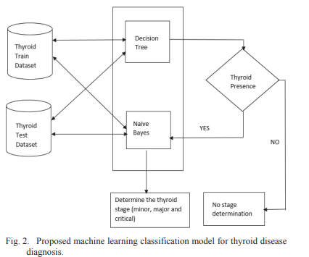

Slide 9
ADVANTAGES
High Accuracy
High Efficiency

Slide 10
HARDWARE REQUIREMENTS
System : i3 or above.
Ram : 4 GB.
Hard Disk : 40 GB

Slide 11
SOFTWARE REQUIREMNTS
Operating system : Windows8 or Above.
Coding Language : python

Slide 12
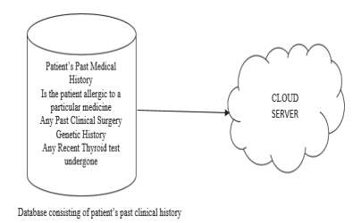
SYSTEM ARCHITECTURE

Slide 13
UML DIAGRAMS
USECASE DIAGRAM

Slide 14
CLASS DIAGRAM

Slide 15
SEQUENCE DIAGRAM

Slide 16
COLLABORATION DIAGRAM

Slide 17
MODULES
Upload Thyroid Dataset: using this module we will upload dataset details and then application will read and display dataset values and then find and plot graph of normal and thyroid patients count
Preprocess Dataset: using this module we will preprocess dataset and then remove missing values and then convert all non-numeric data into numeric data and then shuffle and then split dataset into train and test where application using 80% dataset for training and 20% for testing

Slide 18
Run Naive Bayes Algorithm: using this module we will input 80% dataset to Naïve Bayes to train a model and 20% test data will be applied on trained model to calculate prediction accuracy
Run SVM Algorithm: using this module we will input 80% dataset to SVM to train a model and 20% test data will be applied on trained model to calculate prediction accuracy
Run Random Forest Algorithm: using this module we will input 80% dataset to Random Forest to train a model and 20% test data will be applied on trained model to calculate prediction accuracy
Comparison Graph: using this module we will plot accuracy comparison graph between all algorithms
Predict Disease from Test Data: using this module we will upload test data and then random forest will predict weather test data is normal or contains thyroid disease

Slide 19
CONCLUSION
The proposed work utilizes classification-based machine learning techniques to detect thyroid disease early, ensuring precision and accuracy. These algorithms streamline patient data, eliminating redundancy and simplifying complex procedures. Cost-effective and efficient, they enhance treatment accessibility, making thyroid diagnosis affordable and straightforward.These methods streamline patient databases by eliminating redundant data, ensuring cost-effective and efficient outcomes. The model simplifies thyroid patient treatment, reducing complexity and costs.

Slide 20


